Slide 1

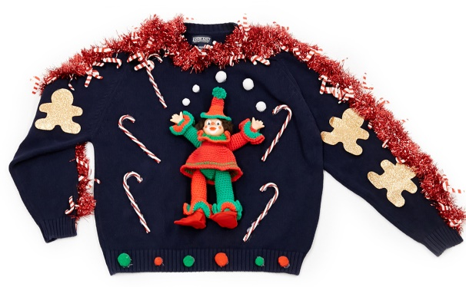
Avoiding a Christmas Wardrobe Malfunction
Matthew Lombardo
Jeremy Coy
Madu Raghunath
John Michals
Presentation on: December 20, 2018

Slide 2
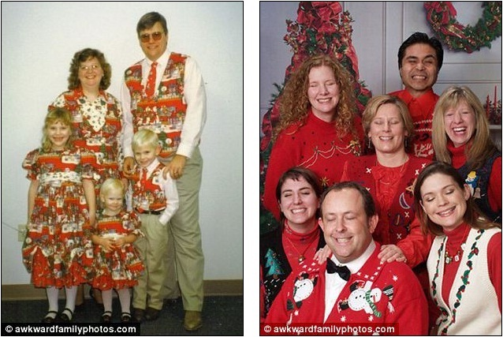
Awkward…..Don’t be them

Slide 3
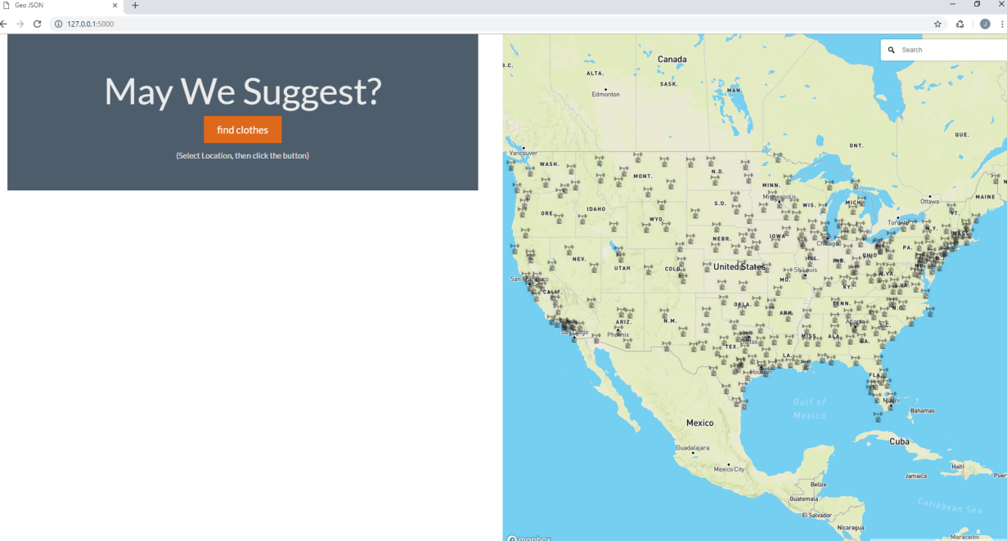
Avoiding a Christmas Disaster

Slide 4
How it works?
Our site allows the user to search for their Christmas travel destination, assess the temperature forecast average for the Christmas holiday based on the GFS American weather model run from December 17th, and then run through a scrapping function that will suggest some ‘appropriate’ outfits given the forecasted climate.
To perform the tasks, we utilized csv provided data from a weather vendor, Commodity Weather Group, transformed it in our flask to JSON and then some GEOJSON formatted data, and ran several new JS libraries.
Turf.JS
Mapbox GL, featuring Geocoder.

Slide 5
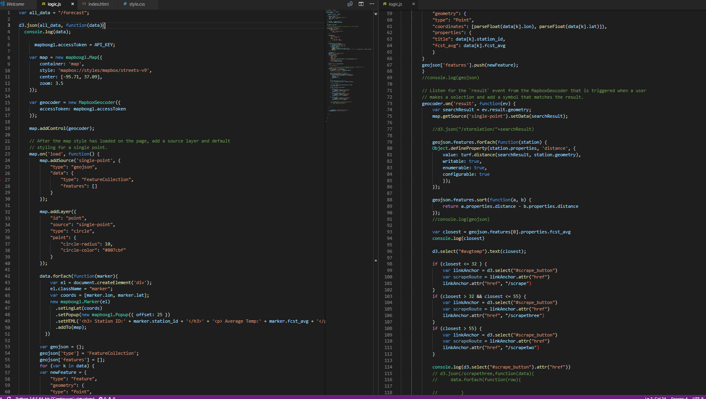
The Code

Slide 6
The New JS
Mapbox GL Geocoder
Mapbox GL is a suite of open-source libraries for embedding highly customizable and responsive client-side maps in Web, mobile, and desktop applications. ‘
Maps render at a super high framerate.
Geocoder allows one to control a search for places using Mapbox Geocoding API.
Turf.JS
Modular, simple to understand JS functionality that utilizes GEOJSON data.
Turf is a collection of small modules
nearestPoint module specifically used
Takes a reference point and a FeatureCollection of Features with Point geometries and returns the point from the FeatureCollection closest to the reference. This calculation is geodesic.

Slide 7
Location Selected, What to Wear?
Now that your location was selected, either by toggling to the nearest weather station and using the tool tip to discover the temperature, you can simply click our scrape button and wait for your clothing suggestions.

Slide 8
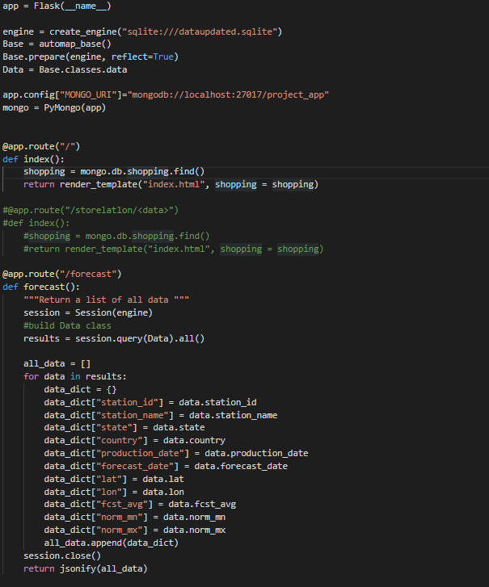
The Scrape Code
Utilized SQLlite and Mongo to perform the database functionality
SQL for our weather data
Mongo for the scrapes
Pictured on the right is the flask code for our weather related data, returning it in a JSON format
On the next slide is an image of how our Mongo DB was utilized to perform the various scrapes, which target the shopping website, Bloomingdales.

Slide 9
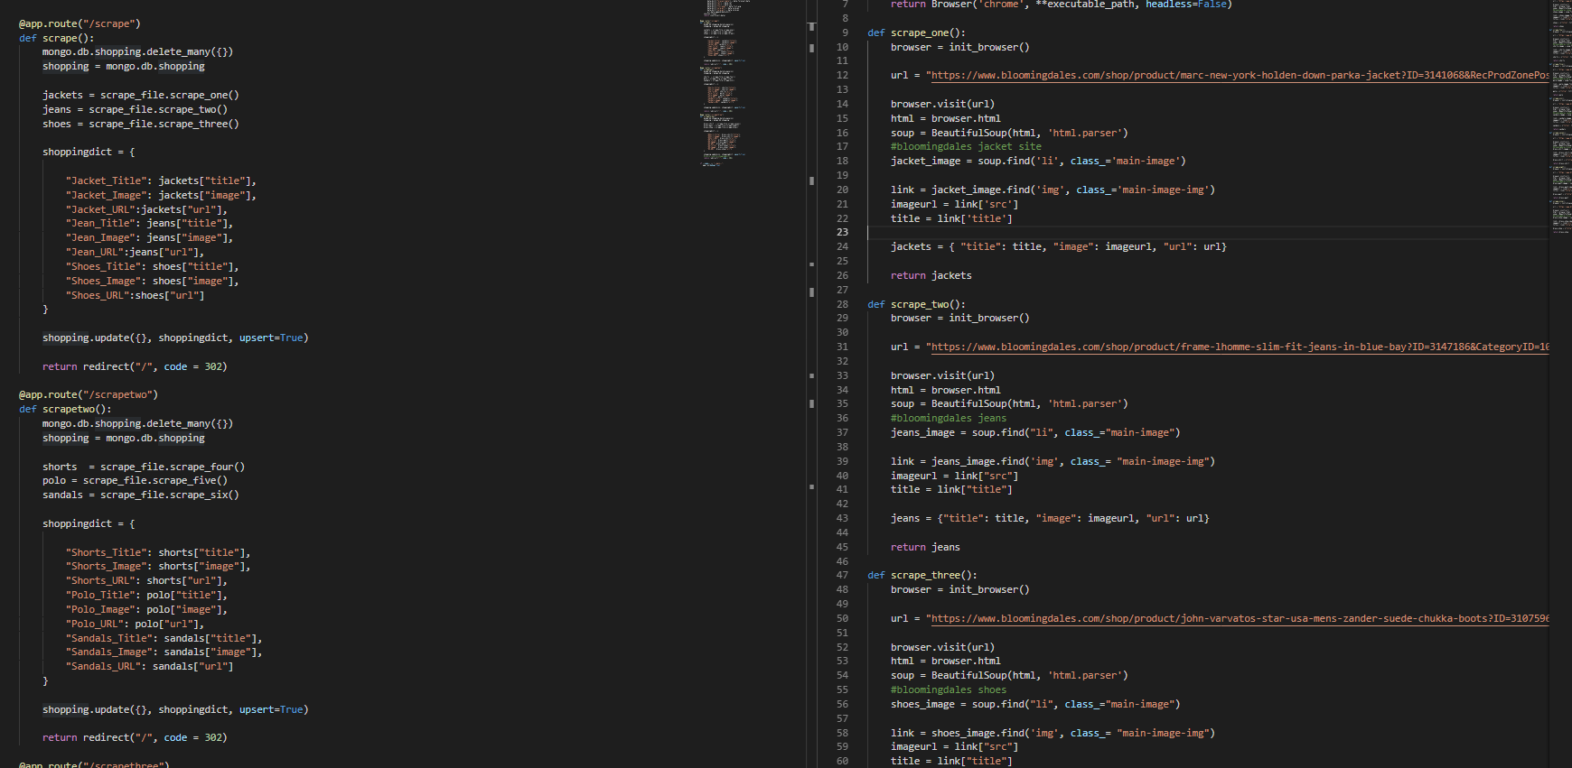
Code continued

Slide 10
Any Questions?

